Slide 1
Computational Thermal Engineering
Rate of convergence and Introduction to C language
DAY 5
Kumaresh Selvakumar

Slide 2
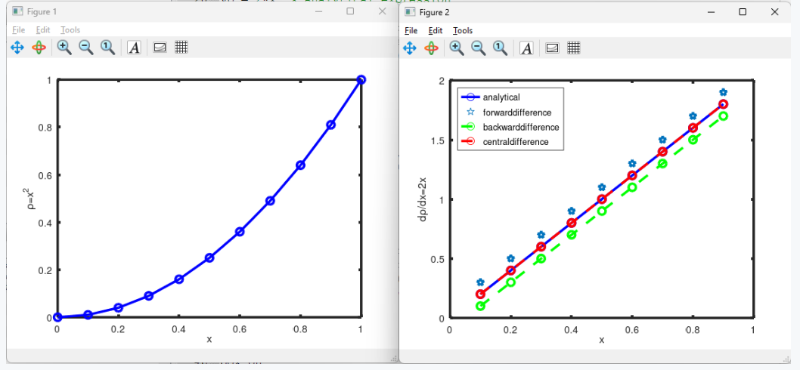
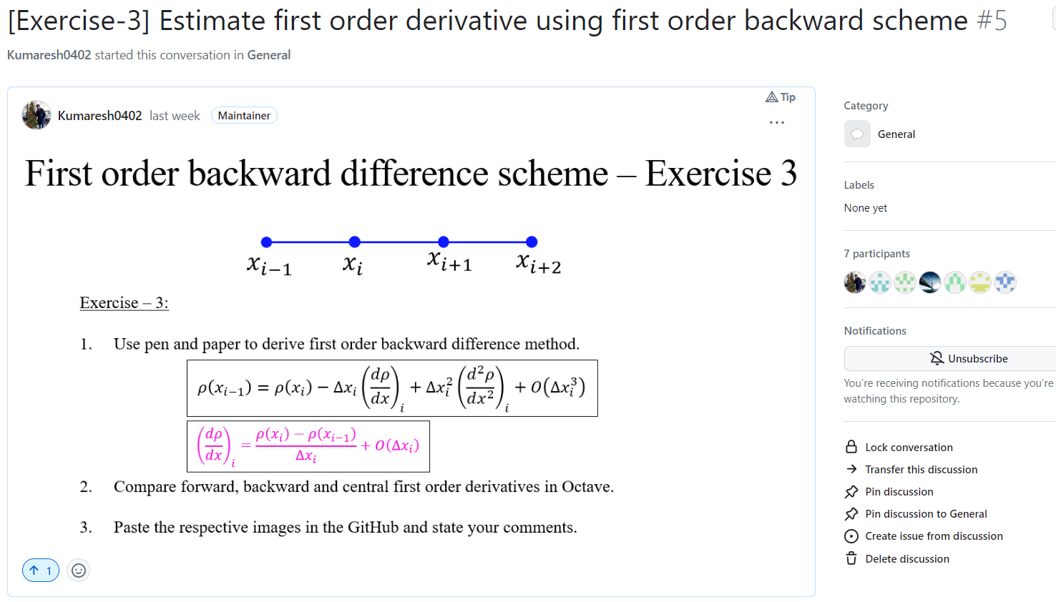
Quick Recap

Slide 3
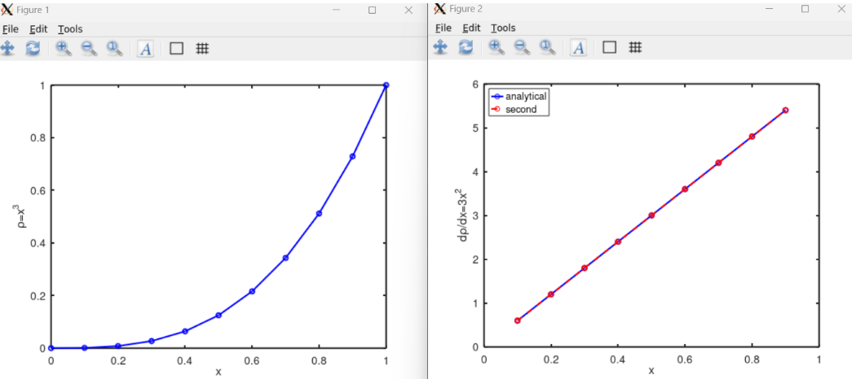
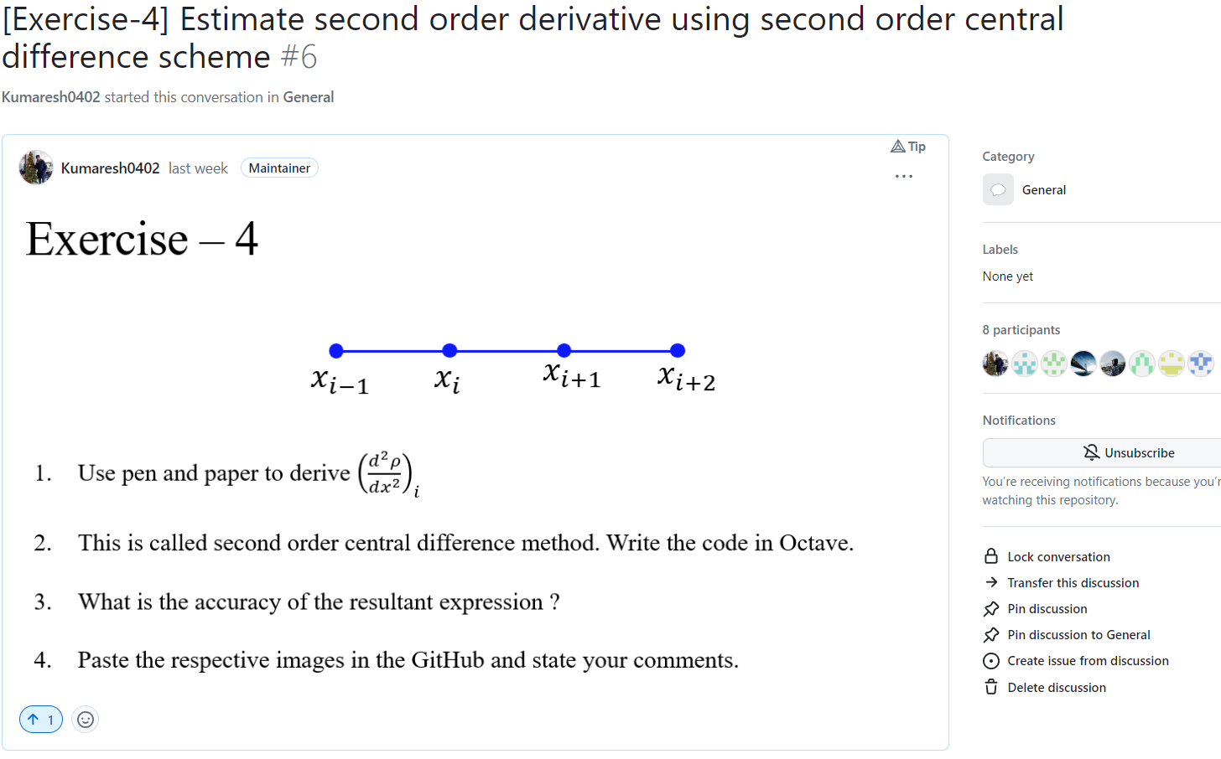
Quick Recap

Slide 4
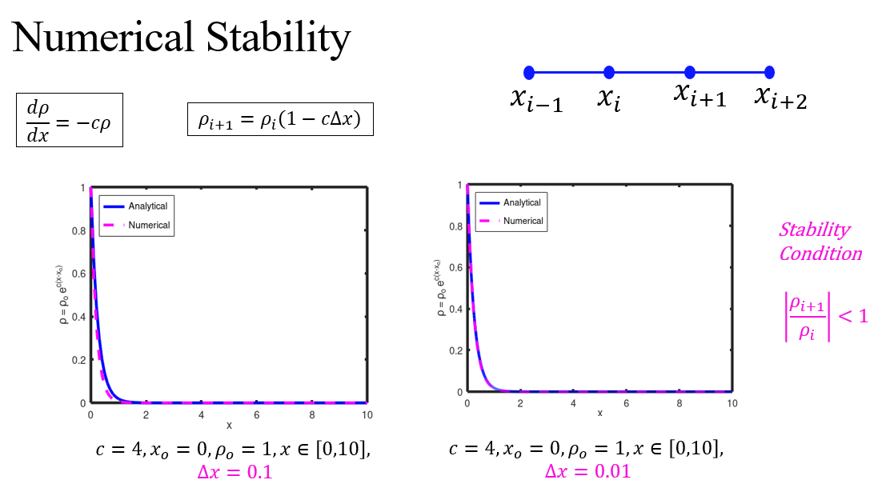
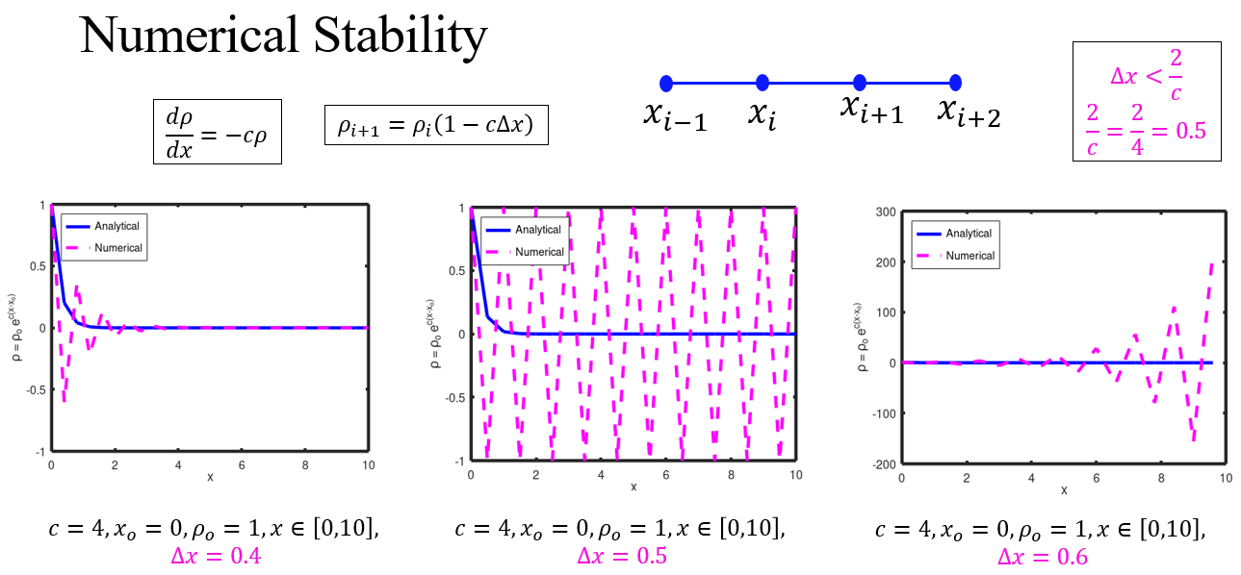
Quick Recap

Slide 5
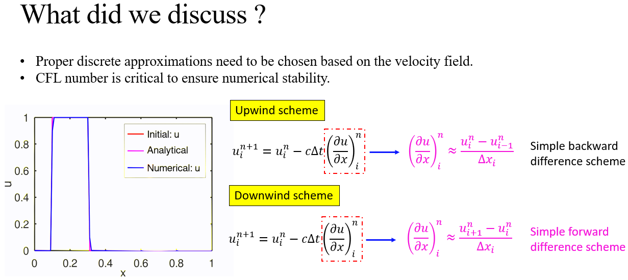
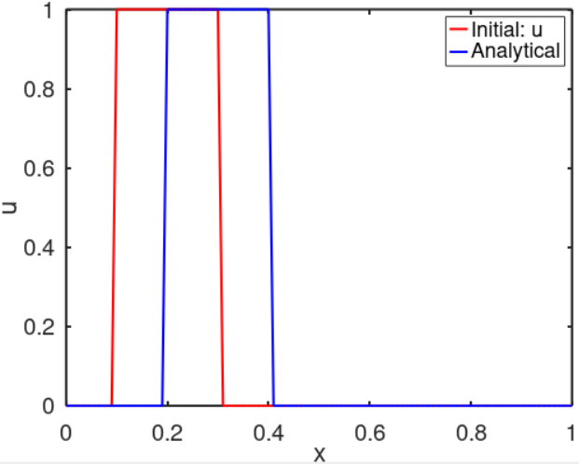
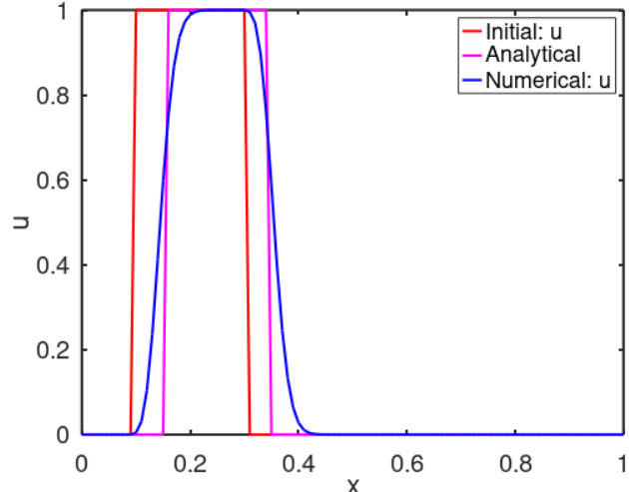
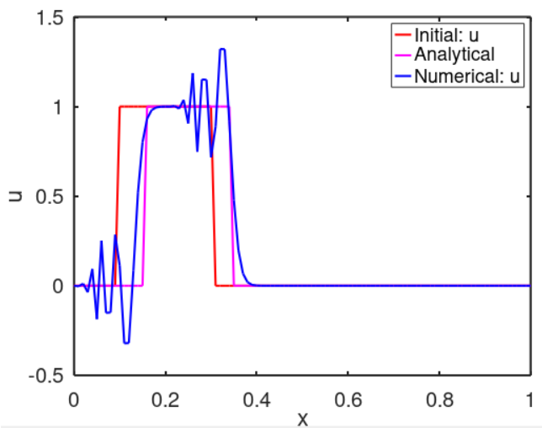
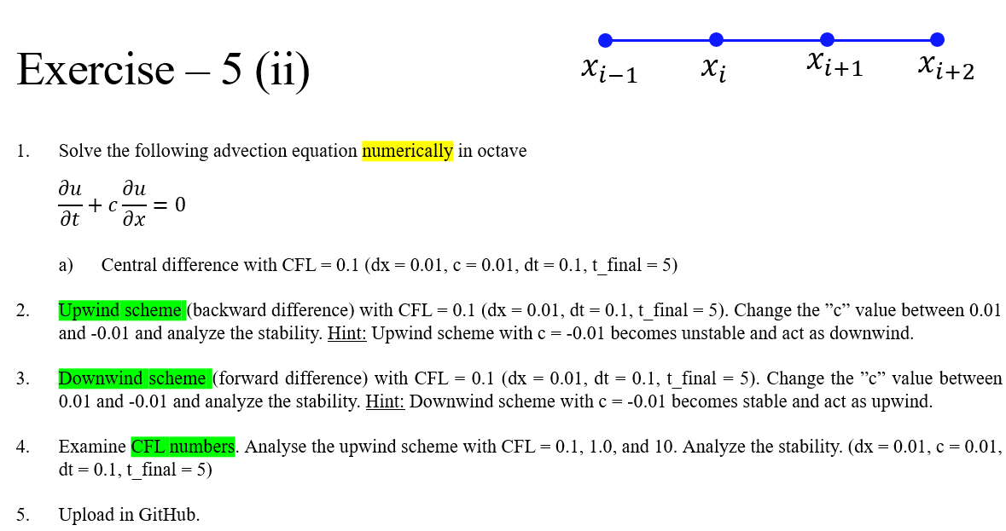
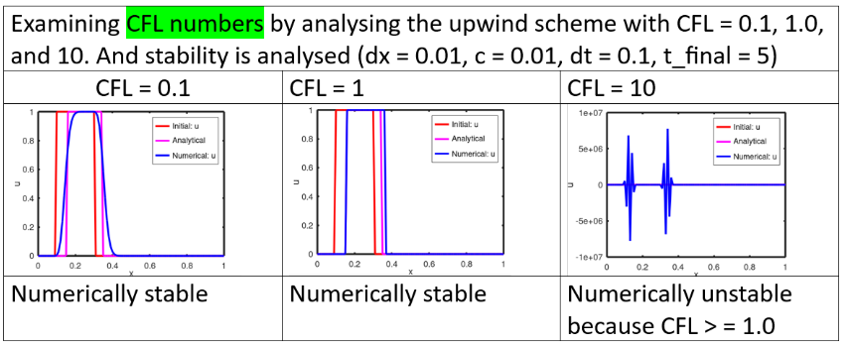
Quick Recap

Slide 6
Contents
Error and Rate of Convergence
Exercise – 6 → to solve error and rate of convergence
Install VS code
Clone the working directory from GitHub
Introduction to C++ for OpenFOAM
Function and classes

Slide 7
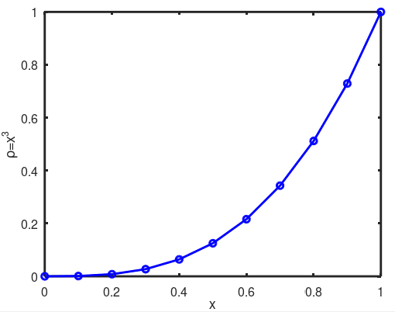
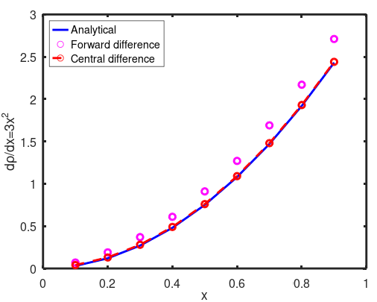
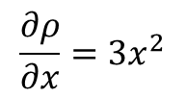
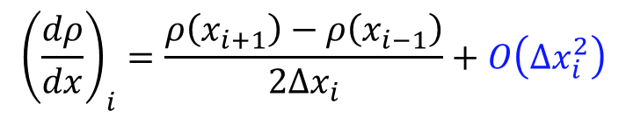

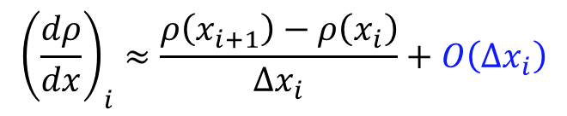
Rate of Convergence
First order forward difference approximation
$${\left(\frac{dρ}{dx}\right)}_{i}≈\frac{ρ\left(x_{i+1}\right)−ρ\left(x_{i}\right)}{Δx_{i}}+O\left(Δx_{i}\right)$$
Second order central difference approximation
$${\left(\frac{dρ}{dx}\right)}_{i}=\frac{ρ\left(x_{i+1}\right)−ρ\left(x_{i−1}\right)}{2Δx_{i}}+O\left(Δx_{i}^{2}\right)$$
$$ρ=x^{3}$$
$$\frac{∂ρ}{∂x}=3x^{2}$$

Slide 8
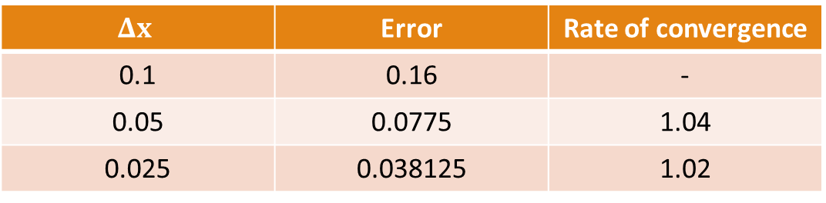
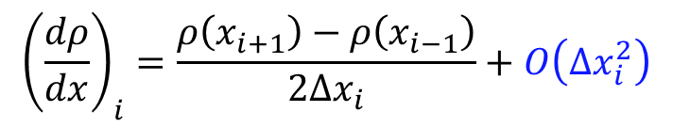
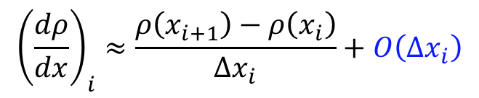
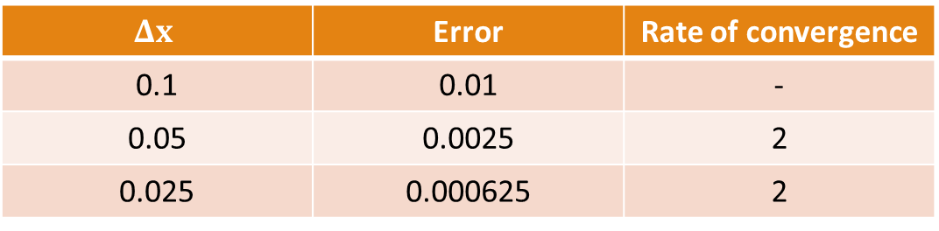
Exercise – 6 (Solve error and rate of convergence)
Check the codes:
5_error_calculate.m
get_rate_of_convergence.m
First order forward difference approximation
$$Δx$$ | Error | Rate of convergence
0.1 | 0.16 | -
0.05 | 0.0775 | 1.04
0.025 | 0.038125 | 1.02
$${\left(\frac{dρ}{dx}\right)}_{i}≈\frac{ρ\left(x_{i+1}\right)−ρ\left(x_{i}\right)}{Δx_{i}}+O\left(Δx_{i}\right)$$
Second order central difference approximation
$$Δx$$ | Error | Rate of convergence
0.1 | 0.01 | -
0.05 | 0.0025 | 2
0.025 | 0.000625 | 2
$${\left(\frac{dρ}{dx}\right)}_{i}=\frac{ρ\left(x_{i+1}\right)−ρ\left(x_{i−1}\right)}{2Δx_{i}}+O\left(Δx_{i}^{2}\right)$$

Slide 9
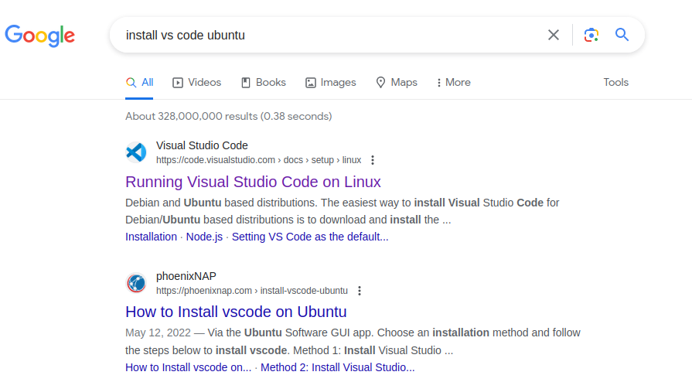
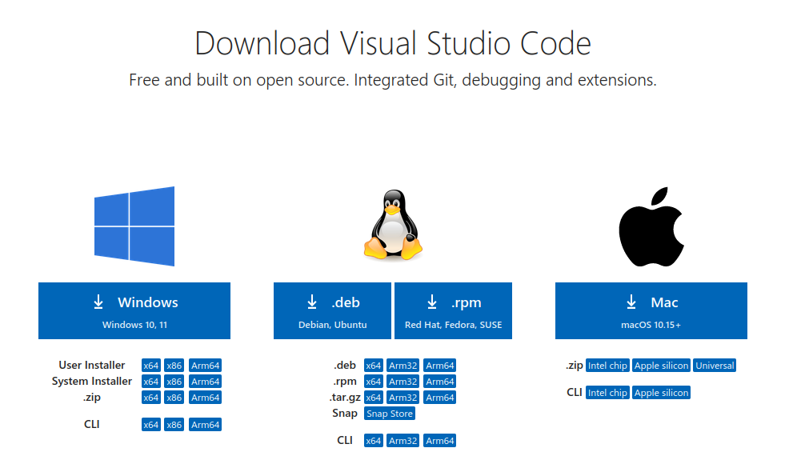
Install VS code

Slide 10
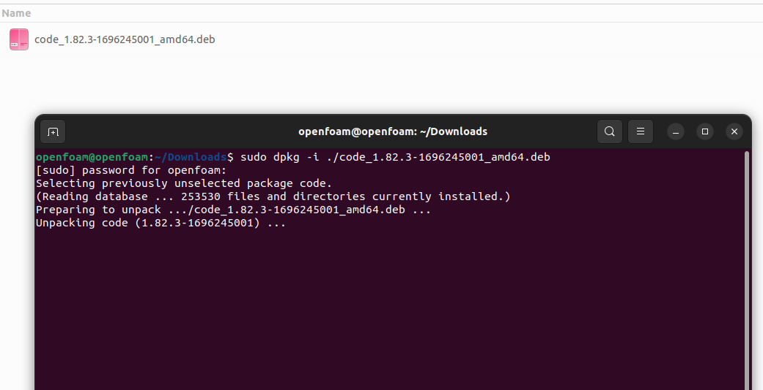
Install VS code
Write this command in your terminal window

Slide 11
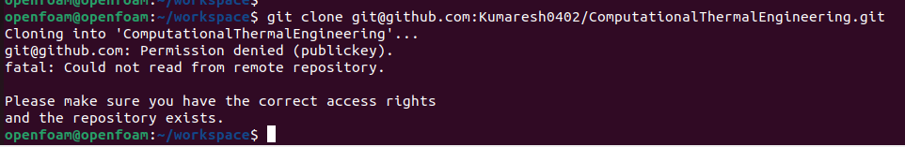
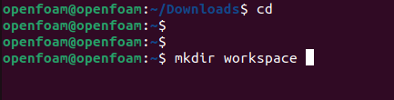
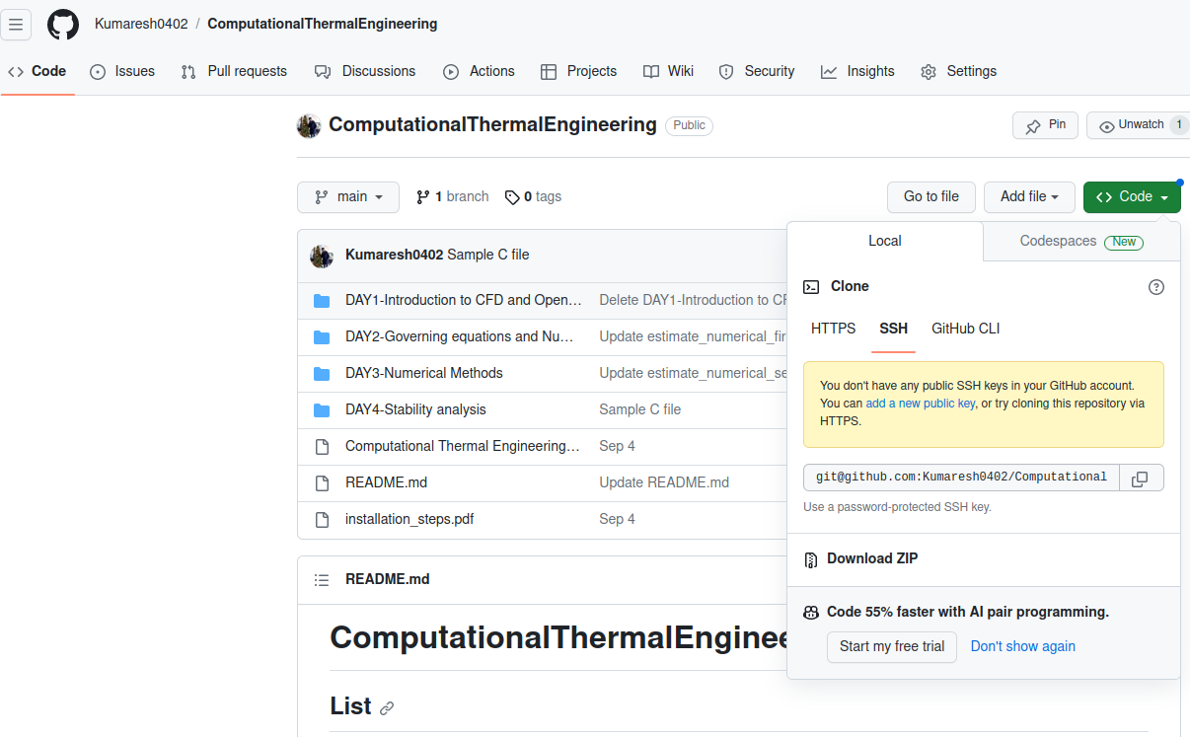
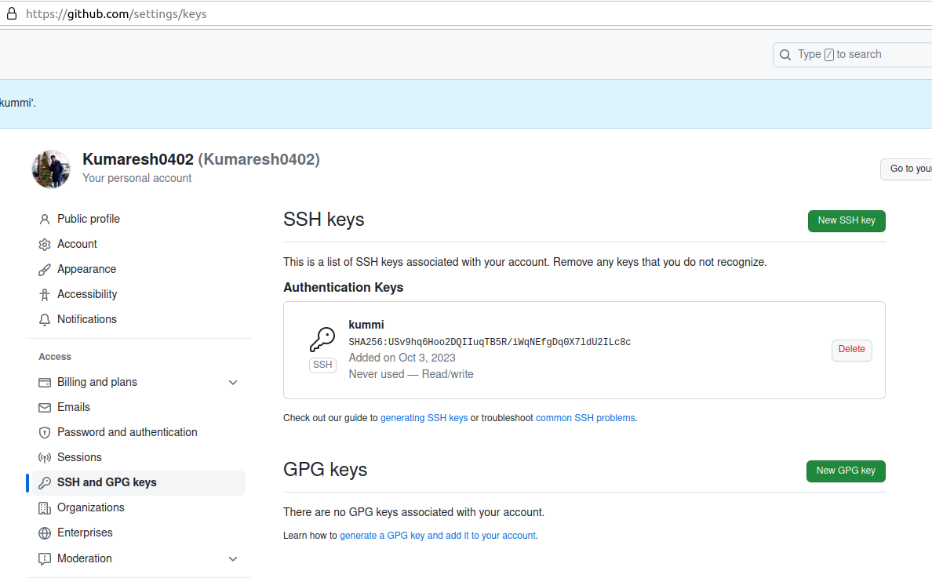
Clone the directory
(1) Create a new directory named “workspace”
(3) If you got the above error, type the following commands in the terminal as follows:
ssh-keygen -t rsa -b 4096
<enter-enter-enter>
cat ~/.ssh/id_rsa.pub
Then copy the entire result from the command (cat ~/.ssh/id_rsa.pub) and paste here by creating New SSH key.
(2) Copy SSH key

Slide 12
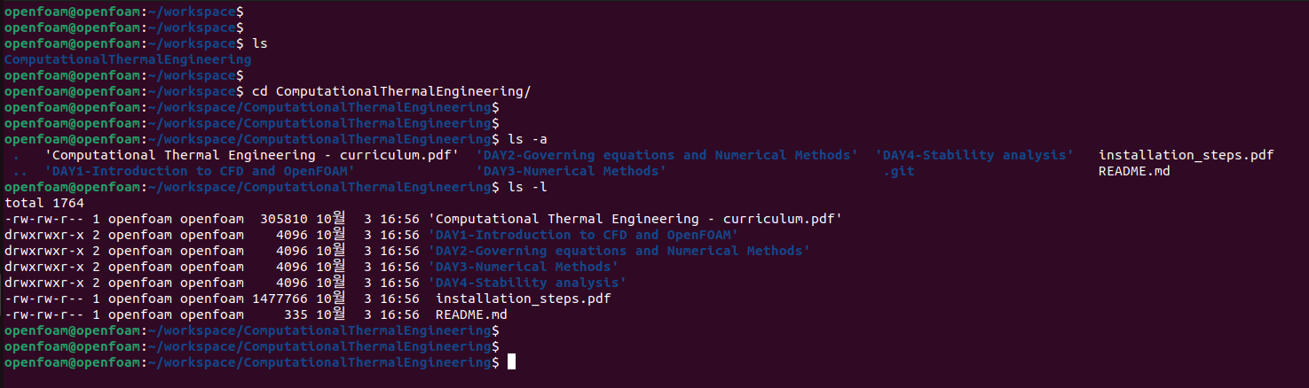
After cloned, working directory from GitHub appears

Slide 13
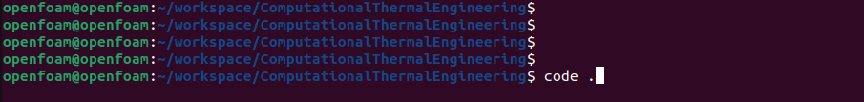
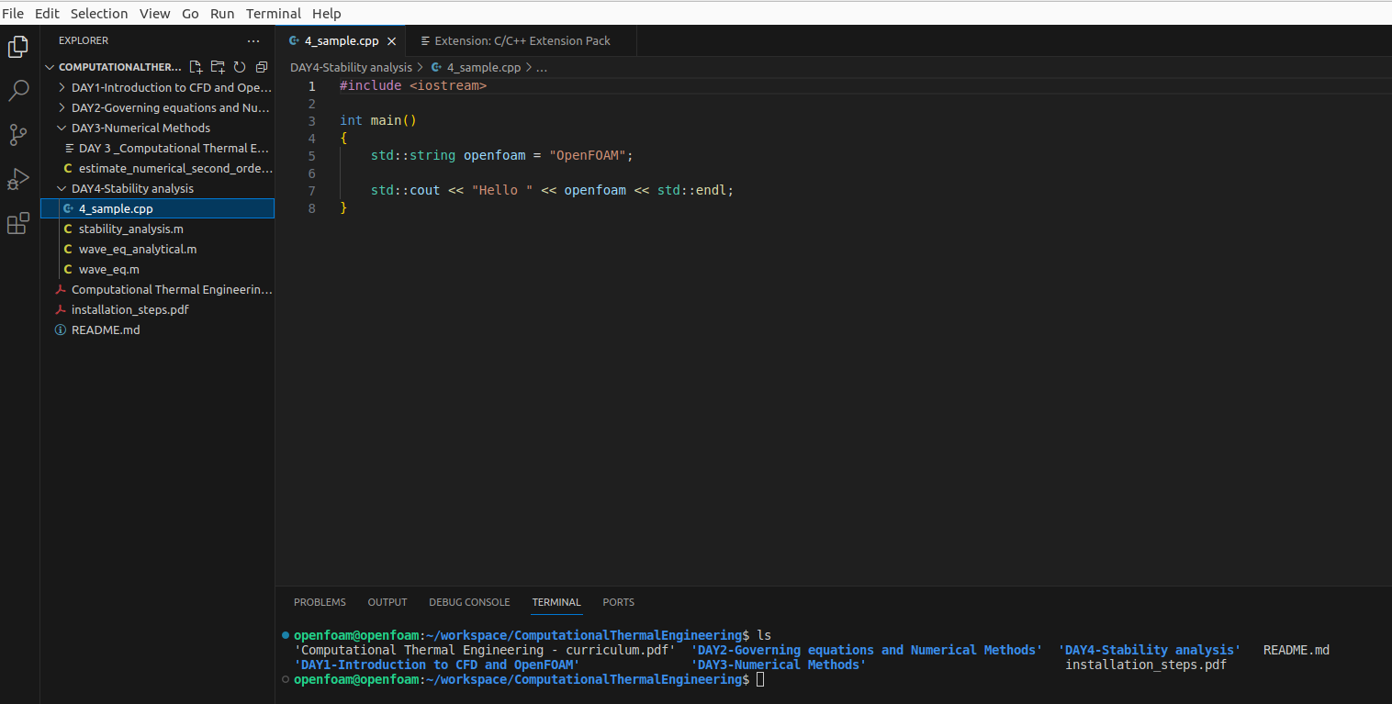
Run VS code

Slide 14
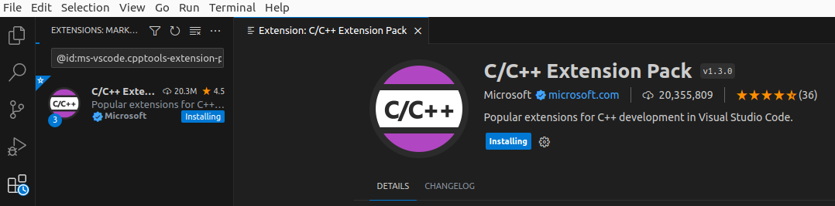
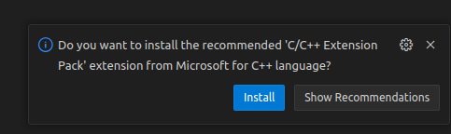
Install C++ packages

Slide 15
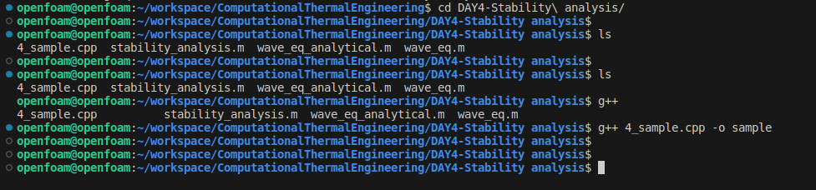
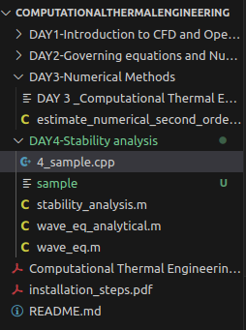
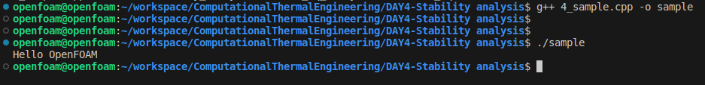
Introduction to C++ for OpenFOAM
Check the code:
5_sampleC.m
Type the command
Output file “sample” appeared.

